Slide 1
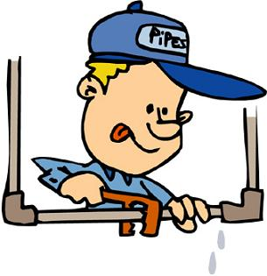
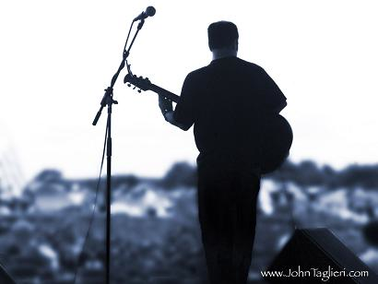
Teacher : schoolteacher is a person who provides education for pupils (children) and students (adults).
doctor : Doctors make people healthier. When people get sick, doctors figure out why.
Plumber : is a tradesperson who specializes in installing and maintaining systems used for potable (drinking) water, sewage, and drainage in plumbing systems
A joiner is a type of a carpenter that cuts and fits joints in wood without the use of nails, screws, or other metal fasteners.
A musician is an artist who plays a musical instrument

Slide 2
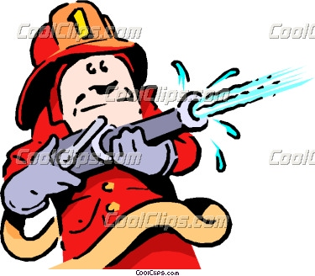
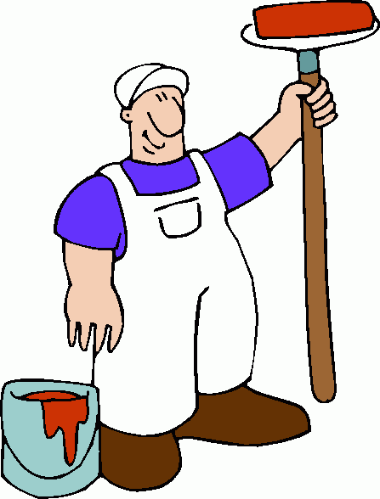
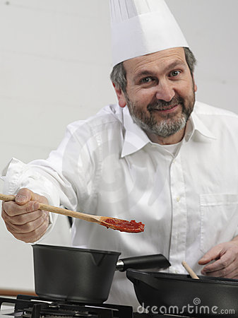
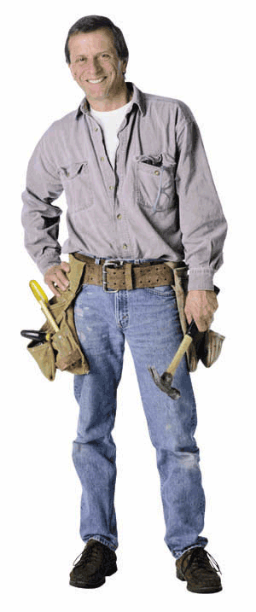
fireman :Stops fires burning.
street cleaner :Keeps the streets clean and tidy.
Cooker : Prepares and cooks food, knows different cuisines of the world.
House-painter : Paints houses, rooms, the walls and interiors.
Builder :Builds and repairs buildings.

